Slide 1
Oracle
Vivek Gohil

Slide 2
Oracle Sample Database
Download the sample database from github
Link :
After downloading the file, you should extract it. The zip file contains the following *.sql files:
ot_create_user.sql is for creating OT user and grant privileges
ot_schema.sql is for creating database objects such as tables, constraints, etc.
ot_data.sql is for loading data into the tables.
ot_drop.sql is for removing all objects in the sample database.

Slide 3
Oracle Sample Database
Create New User
Close the DBA connection and connect using new user.
ALTER SESSION SET "_ORACLE_SCRIPT"=true;
CREATE USER training IDENTIFIED BY trining;
GRANT CONNECT,DBA TO training;

Slide 4
Oracle Sample Database
Execute the ot_schema.sql
Execute the ot_data.sql
Execute the ot_select.sql

Slide 5
Section 1 : Querying Data
This section helps you learn how to query data from the Oracle Database. We will start with a simple query that allows you to retrieve data from a single table.
SELECT – show you how to query data from a single table.

Slide 6
Section 2. Sorting data
ORDER BY – sort the result set of a query in ascending or descending order

Slide 7
Section 3. Filtering data
DISTINCT – introduce you how to eliminate duplicate rows from the output of a query.
WHERE – learn how to specify a condition for rows in the result set returned by a query.
AND – combine two or more Boolean expressions and return true if all expressions are true.
OR– combine two or more Boolean expressions and return true if one of the expressions is true.
IN – determine if a value matches any value in a list or a subquery.
BETWEEN – filter data based on a range of values.
LIKE – perform matching based on specific patterns.
IS NULL and IS NOT NULL – check if an expression or values in a column is NULL or not.

Slide 8
Section 4. Joining tables
Joins – give you a brief overview of joins types in SQL Server including inner join, left join, right join and full outer join.
INNER JOIN – select rows from a table that have matching rows in another table.
LEFT JOIN – return all rows from the left table and matching rows from the right table. In case the right table does not have the matching rows, use null values for the column values from the right table.

Slide 9
Section 4. Joining tables
RIGHT JOIN – learn a reversed version of the left join.
FULL OUTER JOIN – return matching rows from both left and right tables, and rows from each side if no matching rows exist.
CROSS JOIN – join multiple unrelated tables and create Cartesian products of rows in the joined tables.
Self join – show you how to use the self-join to query hierarchical data and compare rows within the same table.

Slide 10
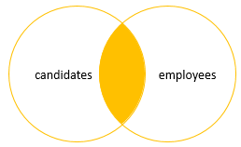
SQL Server Inner Join
Inner join produces a data set that includes rows from the left table which have matching rows from the right table.

Slide 11
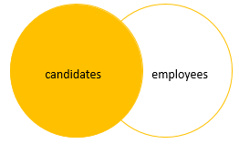
SQL Server Left Join
Left join selects data starting from the left table and matching rows in the right table. The left join returns all rows from the left table and the matching rows from the right table. If a row in the left table does not have a matching row in the right table, the columns of the right table will have nulls.
The left join is also known as left outer join. The outer keyword is optional.

Slide 12
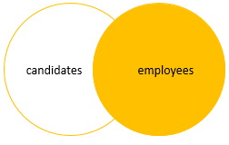
SQL Server Right Join
The right join or right outer join selects data starting from the right table. It is a reversed version of the left join.
The right join returns a result set that contains all rows from the right table and the matching rows in the left table. If a row in the right table that does not have a matching row in the left table, all columns in the left table will contain nulls.

Slide 13
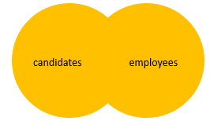
SQL Server full join
The full outer join or full join returns a result set that contains all rows from both left and right tables, with the matching rows from both sides where available. In case there is no match, the missing side will have NULL values.

Slide 14
Section 5. Grouping data
GROUP BY– teach you how to group rows into subgroups and apply an aggregate function for each group
HAVING – show you how to filter a group of rows.

Slide 15
Section 6. Subquery
Subquery – introduce the concept of subquery and how to use the subqueries to perform advanced data selection techniques.
Correlated Subquery – learn about the correlated subquery which is a subquery that depends on the values returned by the outer query.
EXISTS and NOT EXISTS – check for the existence of rows returned by a subquery.
ANY and ALL – compare a value to a list or subquery.

Slide 16
Section 7. Set Operators
This section walks you the steps of using the set operators to combine result sets of two or more independent queries.
UNION – show you how to combine the results of two queries into a single result.
INTERSECT – teach you how to make an intersection of the results of two independent queries.
MINUS – learn how to subtract a result from another.

Slide 17
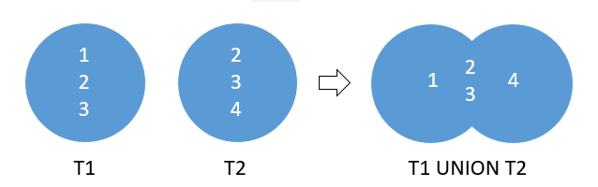
Oracle UNION illustration
Suppose, We have two tables T1 and T2:
T1 has three rows 1,2 and 3
T2 also has three rows 2,3 and 4
The following picture illustrates the UNION of T1 and T3 tables

Slide 18
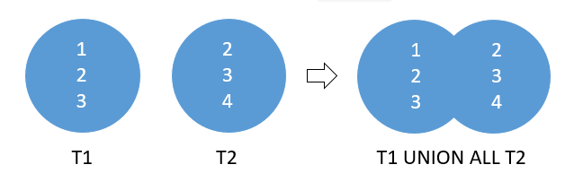
Oracle UNION ALL illustration
The following picture illustrates the result of the UNION ALL of the T1 and T2 tables.

Slide 19
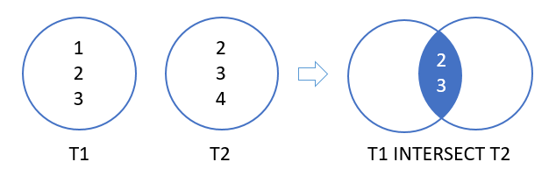
Oracle INTERSECT illustration
Suppose we have two queries that return the T1 and T2 result set.
T1 result set includes 1, 2, 3.
T2 result set includes 2, 3, 4.
The intersect of T1 and T2 result returns 2 and 3. Because these are distinct values that are output by both queries.
The following picture illustrates the intersection of T1 and T2:

Slide 20
Introduction to Oracle MINUS Operator
Like the UNION and INTERSECT operators, the queries above must conform with the following rules:
The number of columns and their orders must match.
The data type of the corresponding columns must be in the same data type group such as numeric or character.
Suppose the first query returns the T1 result set that includes 1, 2 and 3. And the second query returns the T2 result set that includes 2, 3 and 4.

Slide 21
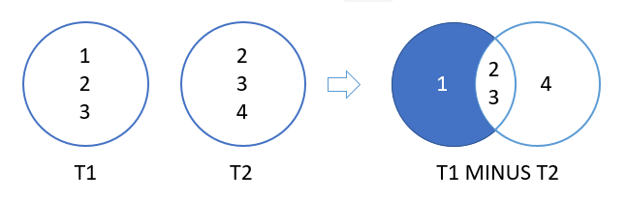
Introduction to Oracle MINUS Operator
The following picture illustrates the result of the MINUS of T1 and T2:

Slide 22
Section 8. Modifying data
In this section, you’ll learn how to change the contents of an Oracle database. The SQL commands for modifying data are referred to as Data Manipulation Language (DML).
INSERT – learn how to insert a row into a table.
INSERT INTO SELECT – insert data into a table from the result of a query.
INSERT ALL – discuss multitable insert statement to insert multiple rows into a table or multiple tables.
UPDATE – teach you how to change the existing values of a table.
DELETE – show you how to delete one or more row from a table.

Slide 23
Section 9. Data definition
This section shows you how to manage the most important database objects including databases and tables.
CREATE TABLE – walk you through the steps of creating new tables in the database.
ALTER TABLE – teach you how to change the structure of existing tables.
ALTER TABLE ADD column – show you how to add one or more columns to an existing table
ALTER TABLE MODIFY column – show you how to change the definition of existing columns in a table.
Drop columns – learn how to use various statements to drop one or more columns from a table.
DROP TABLE – show you how to delete tables from the database.
TRUNCATE TABLE – delete all data from a table faster and more efficiently.
RENAME table – walk you through the process of renaming a table and handling its dependent objects.
Virtual columns – introduce you to virtual columns and how to use them in the database tables.

Slide 24
Section 10. Constraints
Primary key – explain you to the primary key concept and show you how to use the primary key constraint to manage a primary key of a table.
Foreign key – introduce you to the foreign key concept and show you use the foreign key constraint to enforce the relationship between tables.
NOT NULL constraint – show you how to ensure a column not to accept null values.
UNIQUE constraint – discuss how to ensure data stored in a column or a group of columns is unique among rows within the whole table.
CHECK constraint – walk you through the process of adding logic for checking data before storing them in tables.

Slide 25
Section 11.Views
You can use views in many cases for different purposes. The most common uses of views are as follows:
Simplifying data retrieval.
Maintaining logical data independence.
Implementing data security.

Slide 26
Section 11.Views
Creating a view – use the CREATE VIEW statement to create a new view.
Updatable views – discuss how to create updatable views.
WITH CHECK OPTION – how to protect the view using the WITH CHECK OPTION clause of the CREATE VIEW command.
Drop a view – use the DROP VIEW statement to drop a view from the database.

Slide 27
Section 12.Index
Oracle index is one of the effective tools for boost the query performance. However, in order to use it effectively, you must understand it correctly. This section helps you understand and use Oracle indexes to speed up your queries.
Creating a new index – show you how to use the CREATE INDEX statement to create an index for one or more columns in a table.
Removing an index – learn how to remove an existing index by using the DROP INDEX statement.
Unique index – use unique indexes to enforce the uniqueness of values in the index column or columns.

Slide 28
Section 13. Sequence
A sequence is a list of integers in which their orders are important. For example, the (1,2,3,4,5) and (5,4,3,2,1) are totally different sequences even though they have the same members.

Slide 29
What is PL/SQL?
PL/SQL stands for “Procedural Language extensions to the Structured Query Language”
PL/SQL is a highly structured and readable language. Its constructs express the intent of the code clearly.

Slide 30
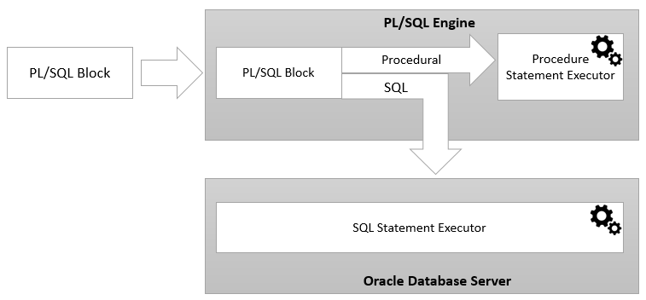
PL/SQL architecture

Slide 31
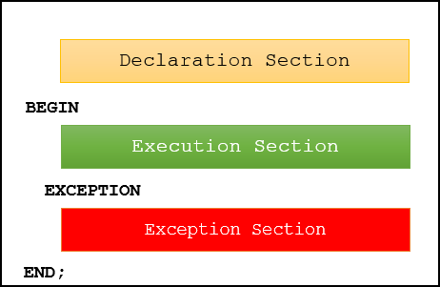
PL/SQL anonymous block overview
PL/SQL is a block-structured language whose code is organized into blocks.
A PL/SQL block consists of three sections:
Declaration
Executable
Exception-handling

Slide 32
Section 14. PL/SQL
What is PL/SQL – introduce you to PL/SQL programming language and its architecture.
Anonymous Block – explain PL/SQL anonymous blocks and shows you how to execute an anonymous block in SQL*Plus and Oracle SQL Developer tools.
Variables – introduce you to PL/SQL variables and shows you how to manipulate variables in programs efficiently.
Constants – learn how to declare constants that hold values that remain unchanged throughout the execution of the program.

Slide 33
Section 15. Conditional control
IF statements – introduce you various IF statement to either execute or skip a sequence of statements based on a condition.
CASE statements – learn how to choose one sequence of statements out of many possible sequences to execute.
GOTO – explain the GOTO statement and shows how to use it to transfer control to a labeled block or statement.

Slide 34
Section 16. Iterative processing with loops
Basic LOOP statement – show you how to use the basic LOOP statement to execute a sequence of code multiple times.
Numeric FOR LOOP statement – learn how to execute a sequence of statements a fixed number of times.
WHILE loop – execute a sequence of statements as long as a specified condition is TRUE.
CONTINUE – use the CONTINUE statement to skip the current iteration of the loop and immediately continue the next iteration.

Slide 35
Section 17. Select Into
SELECT INTO – learn how to fetch a single row from a table into variables.

Slide 36
Section 18. Exception Handlers
Exception – show you how to handle exceptions in a block.
Raise exceptions – learn how to raise an exception explicitly with the RAISE statement.
Using raise_application_error – raise an exception with a user-defined error message.

Slide 37
Section 19. Cursors
A cursor is a pointer that points to a result of a query.
PL/SQL has two types of cursors:
Implicit cursors
Explicit cursors

Slide 38
Implicit cursors
Whenever Oracle executes an SQL statement such as SELECT INTO, INSERT, UPDATE, and DELETE, it automatically creates an implicit cursor.
Oracle internally manages the whole execution cycle of implicit cursors and reveals only the cursor’s information and statuses such as SQL%ROWCOUNT, SQL%ISOPEN, SQL%FOUND, and SQL%NOTFOUND.
The implicit cursor is not elegant when the query returns zero or multiple rows which cause NO_DATA_FOUND or TOO_MANY_ROWS exception, respectively.

Slide 39
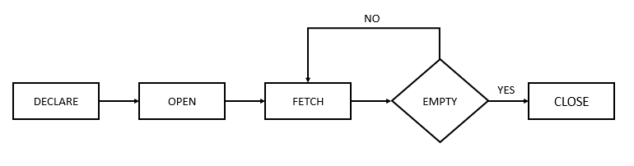
Explicit cursors
An explicit cursor is an SELECT statement declared explicitly in the declaration section of the current block or a package specification.
For an explicit cursor, you have control over its execution cycle from OPEN, FETCH, and CLOSE.
Oracle defines an execution cycle that executes an SQL statement and associates a cursor with it.

Slide 40
Explicit Cursor Attributes
This attribute is TRUE if the cursor is open or FALSE if it is not.
A cursor has four attributes
%ISOPEN
This attribute is TRUE if the cursor is open or FALSE if it is not.
%FOUND
This attribute has four values:
NULL before the first fetch
TRUE if a record was fetched successfully
FALSE if no row returned
INVALID_CURSOR if the cursor is not opened
%NOTFOUND
This attribute has four values:
NULL before the first fetch
FALSE if a record was fetched successfully
TRUE if no row returned
INVALID_CURSOR if the cursor is not opened
%ROWCOUNT
The %ROWCOUNT attribute returns the number of rows fetched from the cursor. If the cursor is not opened, this attribute returns INVALID_CURSOR.

Slide 41
Section 19. Cursors
Cursor – introduce you to cursors including implicit and explicit cursors and shows you how to use them effectively to fetch data from a table.
Cursor FOR LOOP – show you how to use the cursor FOR LOOP statement to fetch and process each row from a cursor.
Cursor with parameters – learn how to use the cursor with parameters to fetch data according to the input arguments passed to the cursor each time it is opened.

Slide 42
Section 20.Stored Procedures and Functions
Procedure – a step-by-step guide to create, compile and execute a procedure from Oracle SQL Developer.
Implicit statement results – learn how to return one or more result sets from a procedure.
Function – show you how to develop a PL/SQL function and explain to you various ways to call a function.
Cursor variables – learn how to use cursor variables using REF CURSOR type.

